Slide 1
UK v USA
Recruitment Issues and Best Practises in hiring
Pete Harding – PFW Associates
&
Sara Hey – Bob Clements International

Slide 2
UK – When do we recruit?
Gut feeling?
Staff feedback on workload ?
Measured expansion, sales per person?
Customer feedback?

Slide 3
USA – When do we recruit?
We hire in our service department based upon our recovery rate.
In Parts, we hire based upon amount of parts sales per person.

Slide 4
UK – Determining Compensation
Compensation is largely marketplace driven.
UK government minimum/living wage
Cost of living variations nationally
Competition for staff locally
Bonus’s on company/departmental performance and efficiency

Slide 5
USA – Determining Compensation
We can pay a Technician 30% of our posted labor rate.
Plus Bonuses based upon efficiency.
20 %
Net Profit
30 %
Tech Pay
35 %
Departmental Costing
15 %
Management

Slide 6
UK – Where do we find employees?
Customers
Local Papers
Agencies
Outplacement
Trade Press
Poaching
Word of Mouth
6

Slide 7
USA– Where to Find Employees
Within our organization
Job recruiting sites
Military veterans
Truck drivers
Volunteer Firefighters
Ask our employees

Slide 8
UK – What are we looking for when we recruit?
All to often we are looking to find the “Unicorn” with all three elements.
However Unicorns are hard to find, expensive and even harder to keep!
Unicorns can come with some cultural/attitude baggage…
If we could just find potential with the
right attitude and develop their skill, knowledge and our own business culture.

Slide 9
USA – What are we Looking for When We Recruit?
We hire attitude and teach skills.
Never underestimate the term “Trial Period”, when setting the initial compensation.

Slide 10
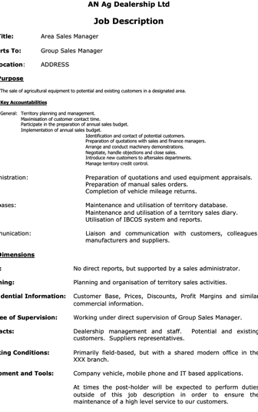
UK – The Importance of Job Descriptions
Job title
Position in the company and to whom the role reports
Clear statement of roles reporting into this position
Where the job is located – depot/home/mobile/field-based etc
Objectives of the role and KPIs/Measures used for assessment
Simple list of main duties for the role

Slide 11
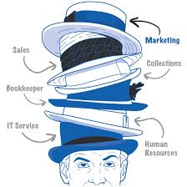
USA – Importance of Job Descriptions
Job descriptions start with the owners.
We want to create clarity for our employees.

Slide 12
UK – How do I Keep Good People?
Hire the right people in the first place, We get the people we deserve
Lead your team, Don’t just be a Boss
Encourage them to grow and learn to bring new ideas
Be a brand they can be Proud of, look at premises, vehicles, market your business
Competitive salary’s and benefits, remember its not all about the money
Culture, Have a positive team attitude deal with any “black holes”

Slide 13
USA – How do I Keep Good People?
Ask yourself if you would like to work for you
Identify areas for training and start it early
Always be willing to ask, “is there anything that we can do to make your job more enjoyable.”

