Slide 1
What a green services company wants from a dealership

Slide 2
Angus Lindsay – Group Head of Assets and Fleet
That’s me

Slide 3
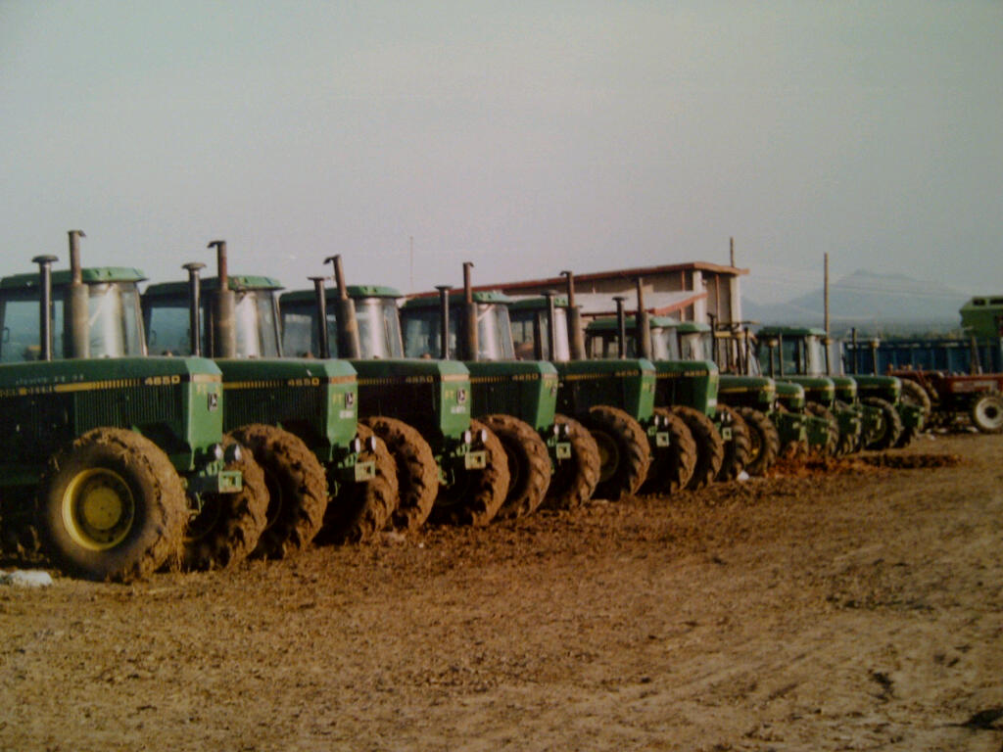
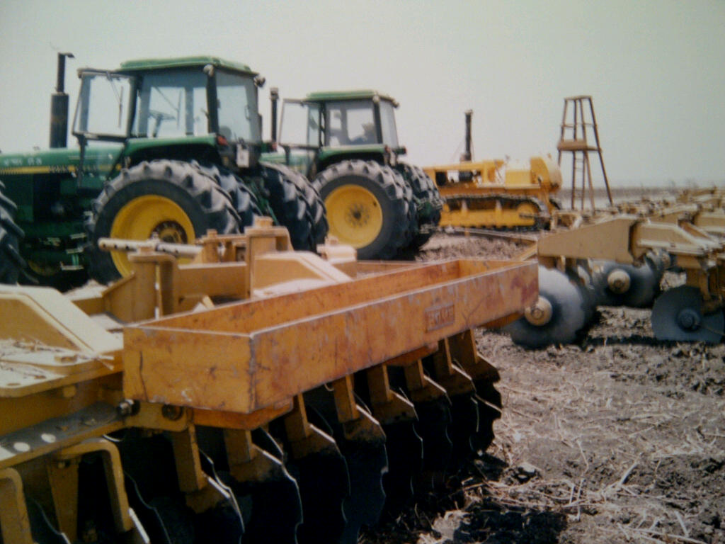
Background in agriculture both in UK and overseas

Slide 5
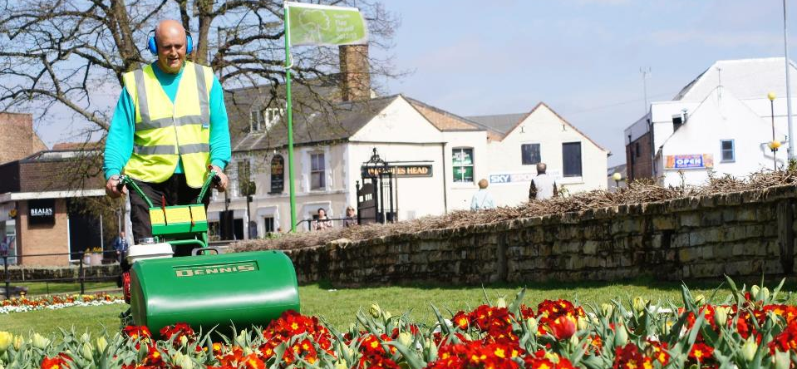
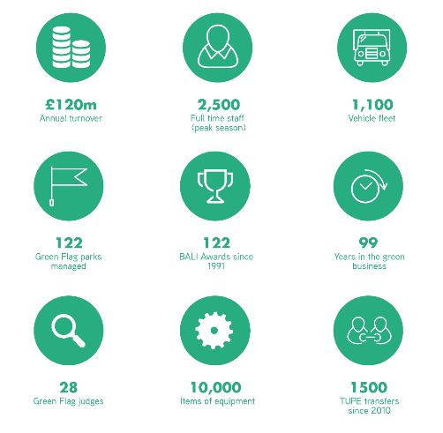
Who we are and what we do

Slide 6
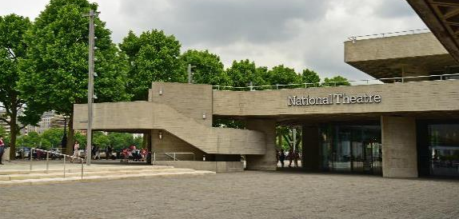
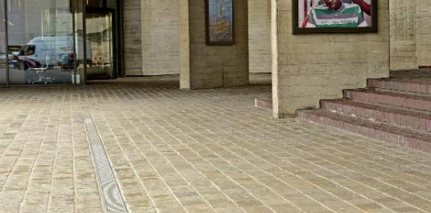
BALI Award Winner 2018
Theatre Square, Royal National Theatre
Hard Landscaping
£375,499.24 Project
Winner of BALI Award 2018
reinforced concrete, surface
water drainage systems
steps and handrails
masts, paving, furniture and lighting.

Slide 7
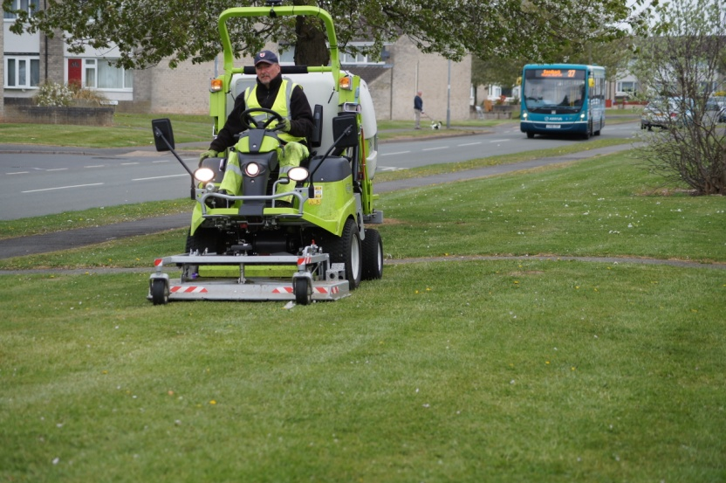
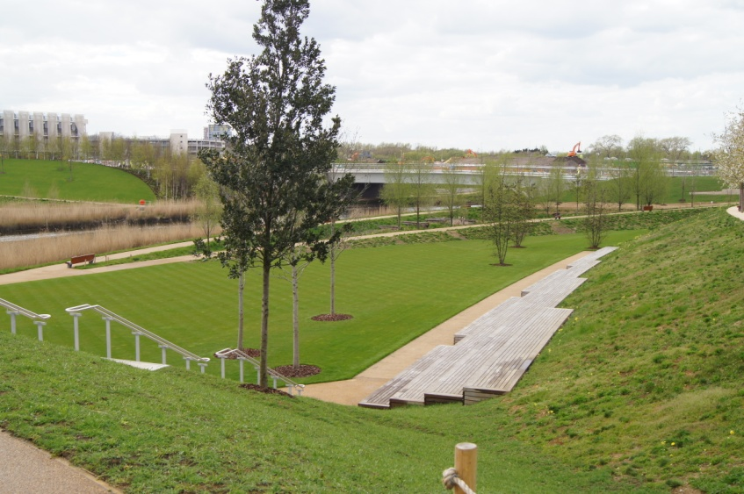
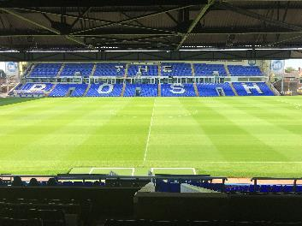
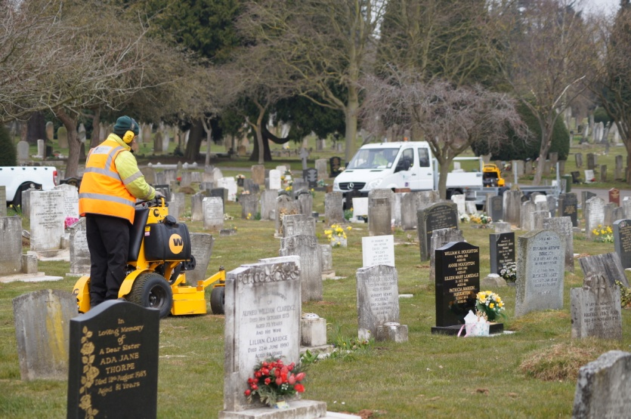
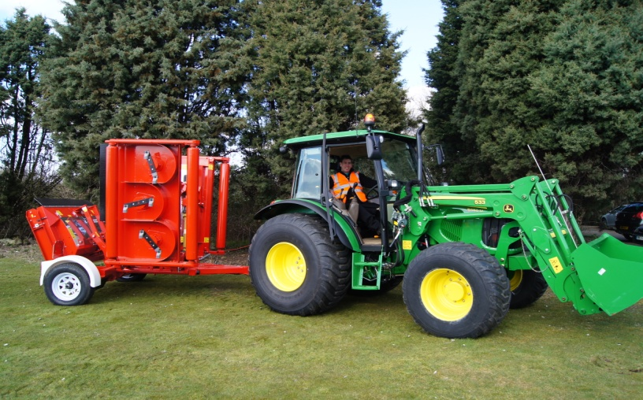
Diversity of Contracts

Slide 8
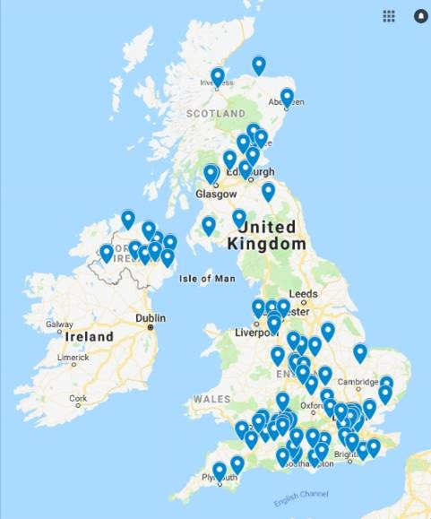
Locations
90 Depots
50+ Local Authority contracts
30+ Housing Associations
600 schools and universities
10+ Integrated Support Services
MIXTO exclusive supplier/ installer for the UK

Slide 9
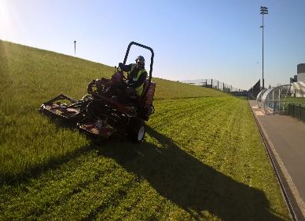
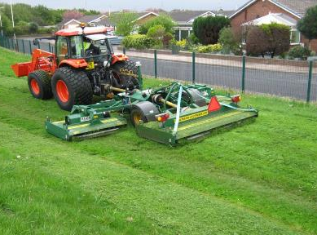
Our grounds maintenance world
Whilst all operational sites have a dedicated compliment of machinery, specialist equipment is shared across the business to ensure maximum utilisation and asset flexibility.
Over the last four years the group has spent an average of £2.8 million per annum on equipment for new contracts and updating the existing fleet.
Annually the business replaces around 20% of it’s vehicle fleet, around 200 vehicles built specifically for grounds maintenance operations.
We make a point of using suppliers local to the operational contracts. This spreads our investment across suppliers and manufacturers, which is better for us and better for the industry

Slide 10
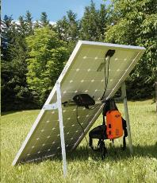
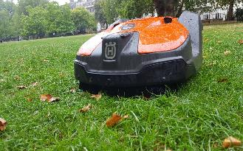
Forward thinking
Smarter working is the key to us maintaining productivity and efficiency.
We shouldn’t be afraid to move on from the comfort of the past by looking for new innovations for improved efficiency.
We actively work with manufacturers to develop new technologies and techniques in line with client, contract and economic demands.
This tends to be an art rather than a science.

Slide 11
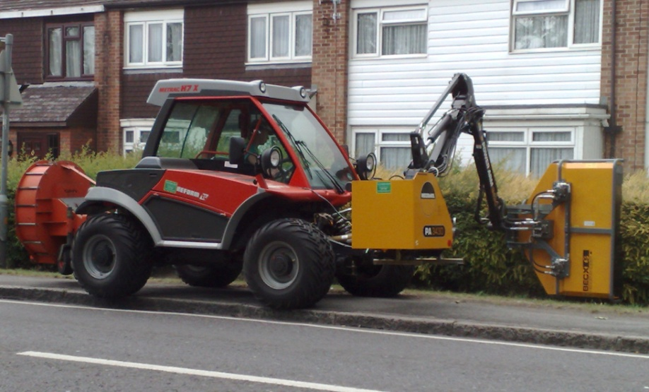
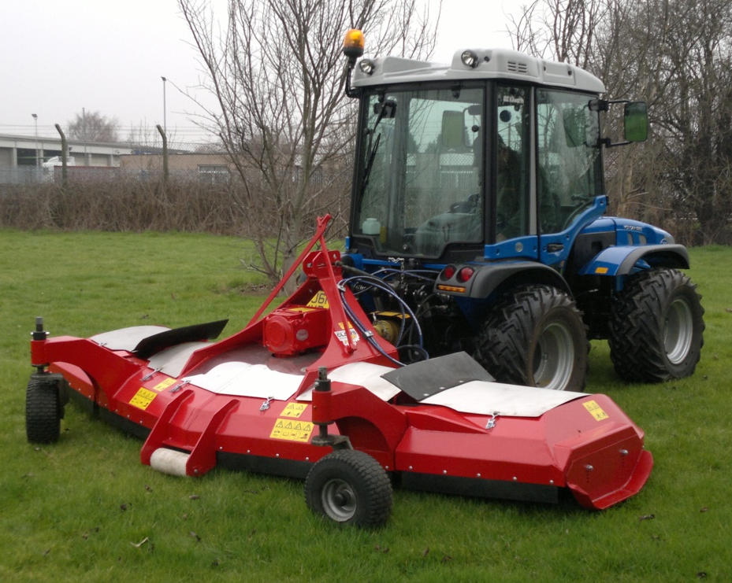
Planning ahead -
Equipment is replaced on an ‘as and when’ required basis and not just ‘out with the old, in with the new’.
Client and operator input is important in all replacement decisions.
Key considerations are: safety, versatility, reliability, operator training, dealer and manufacturer support and finally cost.
We look to agriculture to find further efficiencies: systems tractors, one pass operations, infrared weed spraying, GPS guidance, field mapping etc.
Developing a bespoke GPS based machine productivity monitoring program.
Equipment needs to be strong and simple, no need for bells and whistles - we’re not that kind of industry.

Slide 12
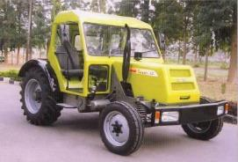
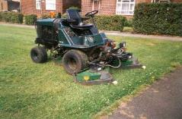
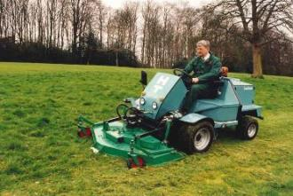
- whilst looking to the past for ideas
Don't be afraid to think differently. The high speed tractor was originally seen as radical but now it’s the norm.
More flexibility from power units is a must in today's marketplace, there’s no place for the one trick pony.
Interchangeable units on a power unit – it’s not a new concept.
Upskilling has to be the way forward.

Slide 13
Future industry issues - climate, budgets, clients, skills, constraints
Climate and budget constraints mean changes to age old practices but we have the equipment to do the job?
People and machines are our biggest costs - how do we make them more productive?
Increasing fuel costs, what are the alternatives, if any; We have hybrid cars – what about hybrid mowers or tractors – don’t just restrict them to the golf course.
There is a serious skills shortage within the industry and difficulty in attracting people into it.
Robotic mowing has got to be the way forward – hasn’t it?

Slide 14
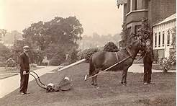
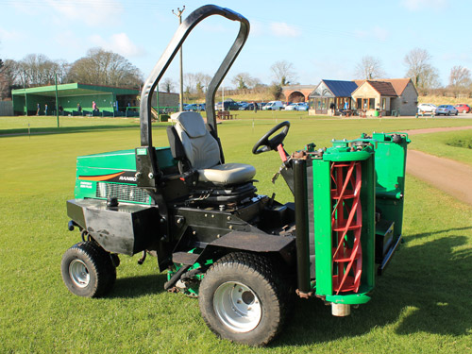
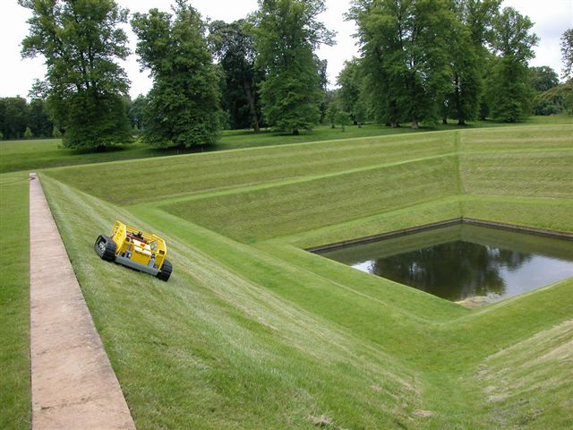
Industry issues affecting both customer and supplier.
Our industry is not glamorous, we don’t pay Rock Star wages and we’re not a high margin business awash with skilled staff and understanding clients.
Machinery and equipment is not always treated as it should be, and in many cases not fully utilised, a throw back from Local Authority days in times of plenty.
Delays in tender awards mean that when we need machines we need them tomorrow and when something breaks down we need the part yesterday.
Todays economic climate dictates that everybody wants more for less with client inflexibility a major headache when budgets are squeezed and regimes change.

Slide 15
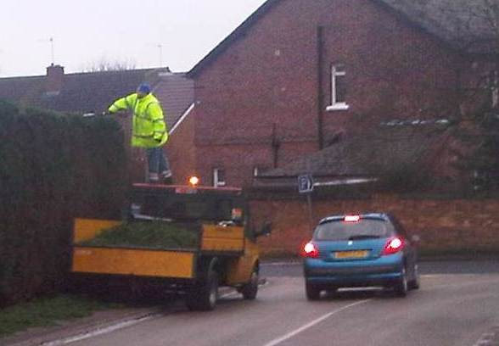
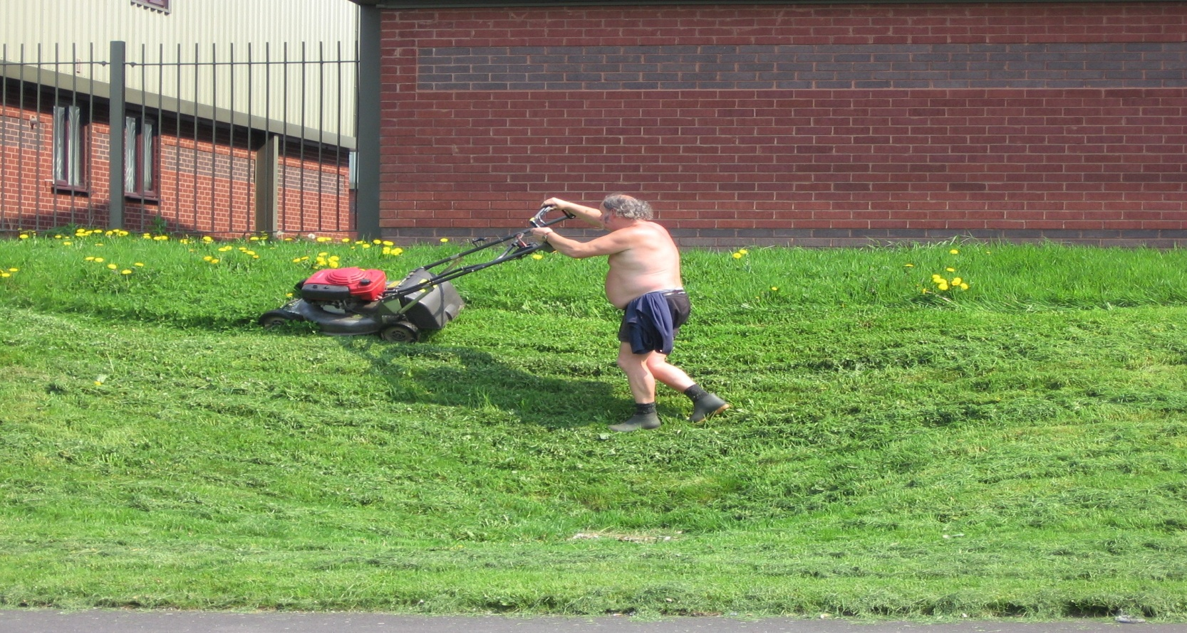
Industry issues affecting both customer and supplier.
Climate change and the environment are high on clients agenda but realistic and workable solutions are currently difficult to implement due to lack suitable alternatives.
A significant lack of skilled or inexperienced people within our industry at all levels is making the job more difficult and professionalism is suffering.
Controversially I think the grounds maintenance industry is developing slower than agriculture or construction with the exception of fine turf and sports ground maintenance.
Health & Safety is becoming a greater influence on what we do and how we do it and has a significant affect on how the industry in general is viewed.

Slide 16
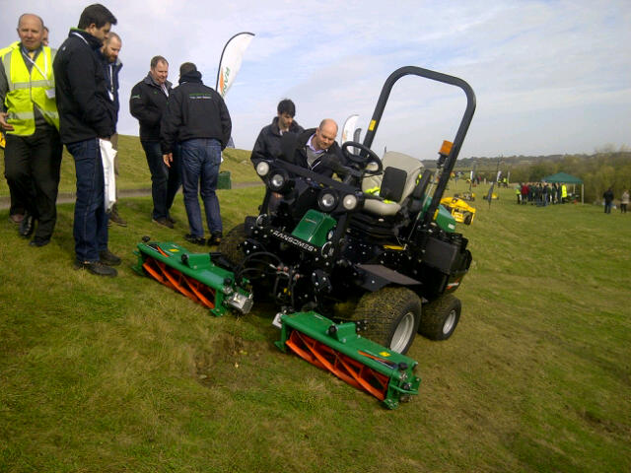
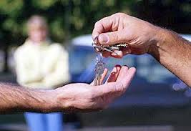
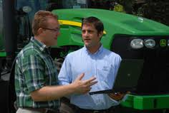
So what do we want from a dealership ?
Good communication from both sides and an openness to discuss ideas and issues no matter how trivial or bizarre builds a good working relationship.
When failures occur (and they will), work proactively to reach a solution, remember it may not be the operator/product/lack of maintenance/parts supply/dealer – delete where applicable, that’s at fault.
Most of all understand your customer and listen to their problems, work with them to reach a solution; selling the product is easy – supporting it through its life so they come back again is the difficult bit.

Slide 17
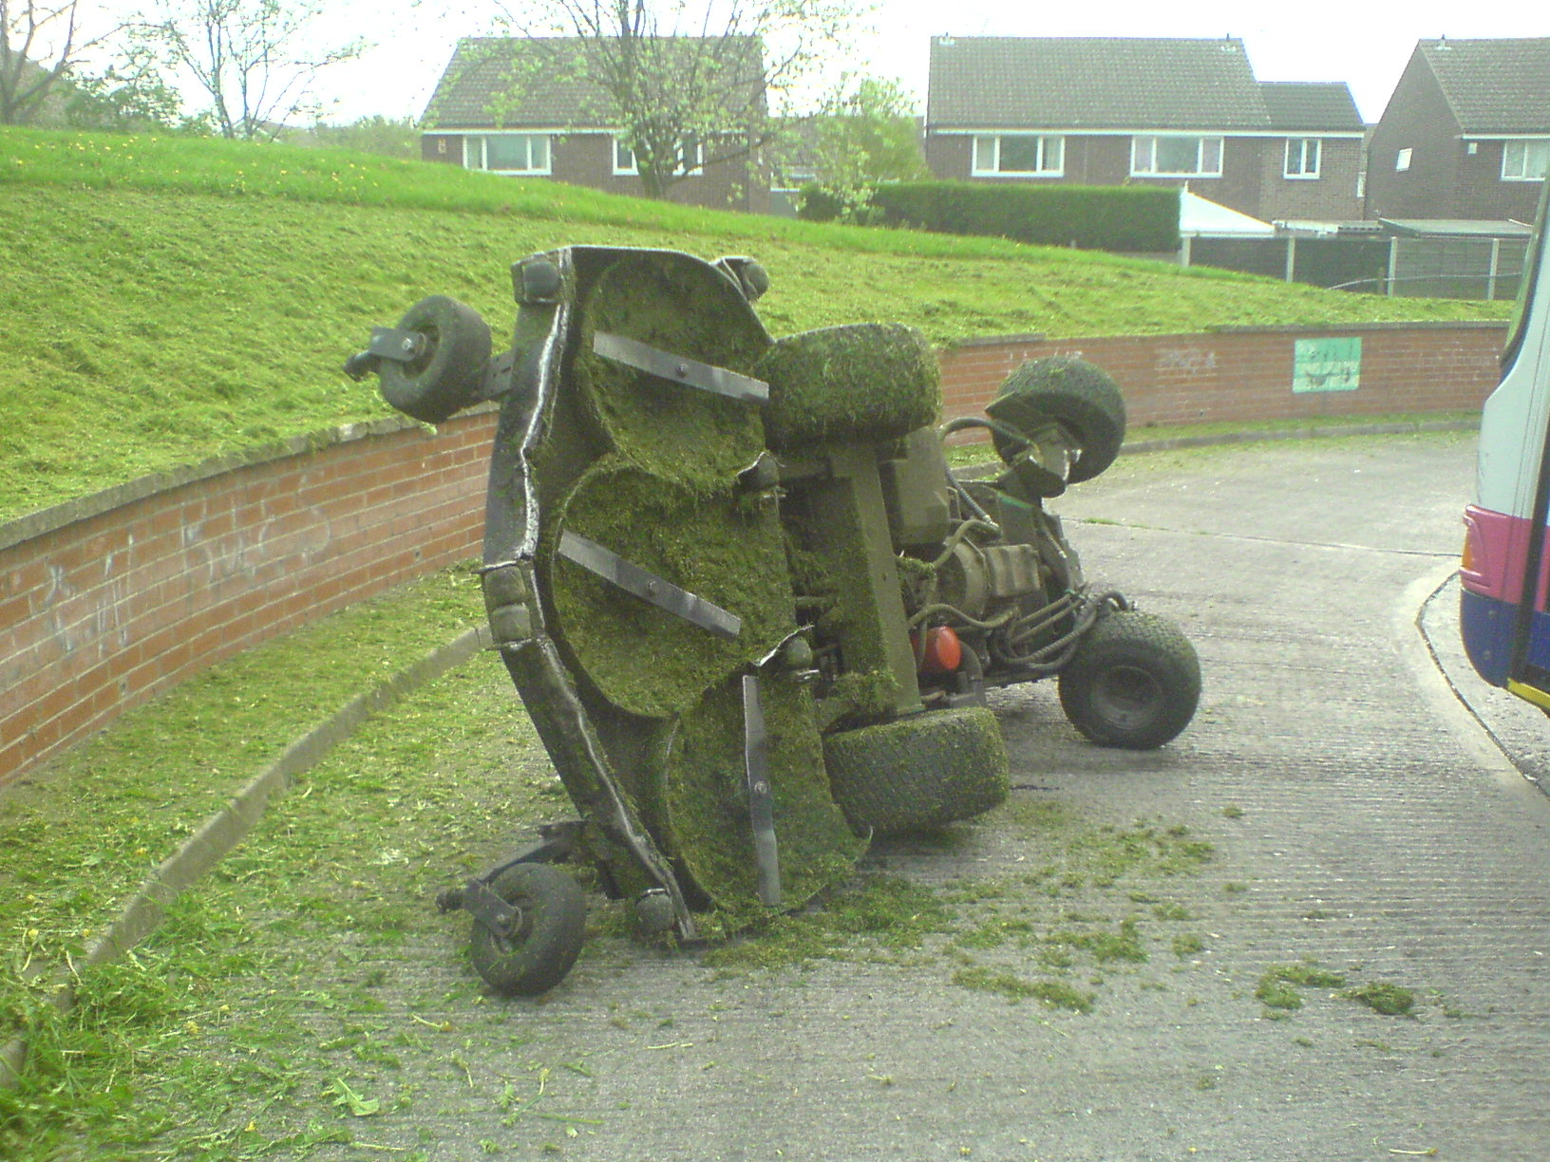
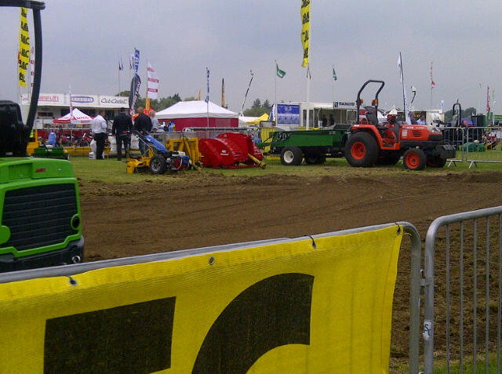
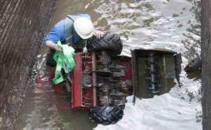
So what do we want from a dealership ?
Machinery demonstrations are part and parcel of the dealers role but it is important that these are done for the right reasons, don’t automatically expect an order at the end.
Accidents will happen and its in all our interests to ensure their frequency is reduced and we learn from them by keeping health & safety at the forefront of what we do.
It’s not always about the initial cost of the equipment, we do a lot of work in the background with manufacturers and importers to ensure we are getting the right machine for the job and ease the pressure on the dealership which sometimes gets forgotten.

Slide 18
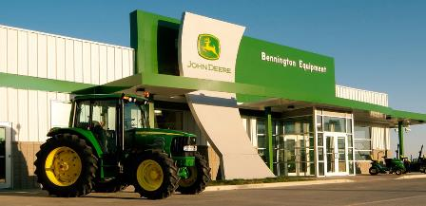
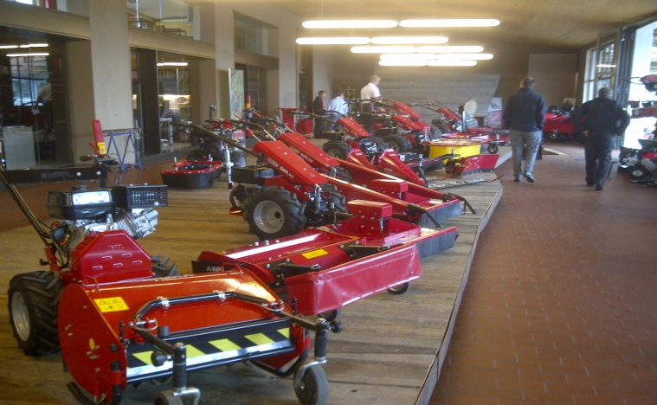
In summary - the role of the dealer.
Some may disagree but I firmly believe the local dealer with manufacturer support is a key supporting asset for a national contractor.
With national pricing agreed with the manufacturer or importer the sales team become the aftermarket support.
Service, repair, parts support and training is invaluable but don’t loose focus.
With so many franchises available to the dealer, where does their loyalty lie – avoid collecting franchises you can’t support.
A flashy showroom is very nice as long as the aftersales lives up to the front of house.

Slide 19
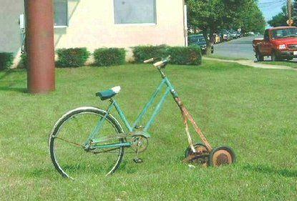
Constantly challenge what you do and how you do it
There’s nothing wrong with being a follower but it’s more fun and more rewarding being an innovator.
We should all be working towards the same goals in an effort to make the industry better for all involved.

